Slide 1
Probability Function for Discrete Variables

Slide 2
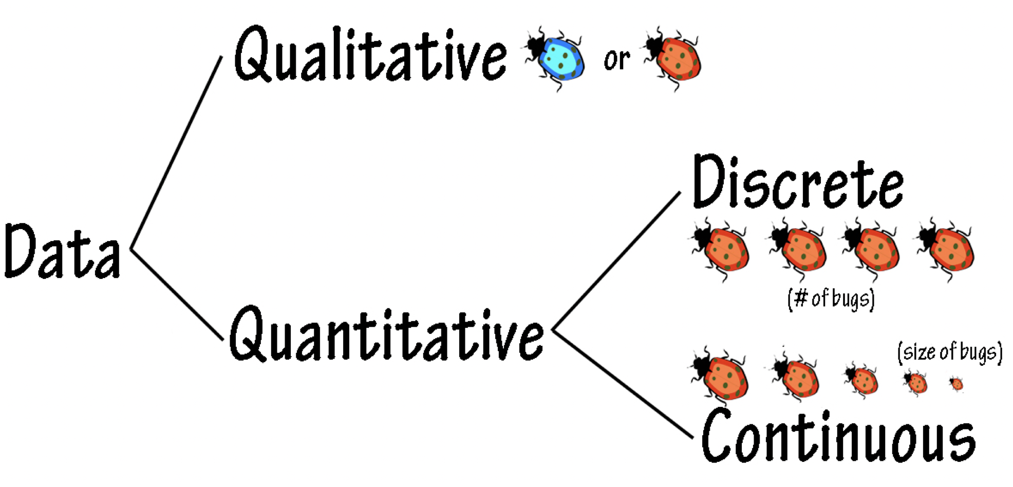
Discrete vs Continuous

Slide 3
Types of Random Variables
Discrete random variables: Random variables that can take a countable number of distinct values (like the possible outcomes of rolling dice).
Continuous random variables: Random variables that can take an infinite number of values in an interval (such as the temperature of Tokyo on any August day).

Slide 4
Discrete and Continuous Random Variables
Discrete random variables have countable values, such as the outcome of a 6-sided die roll.
Continuous random variables have an uncountable amount of possible values and are typically measurements, such as the height of a randomly chosen person or the temperature on a randomly chosen day.

Slide 5
Probability Distribution
“Distribution” or, “Probability Distribution” in Data Science or, in Statistical Analysis provides the “possible value” of a variable and how often they occur using a mathematical function.

Slide 6
Probability Distribution Functions
PMF
Probability Mass Function
PDF
Probability Density Function
Applies on Continuous Variables
CDF
Cumulative Distribution Function
Applies on both Discrete and continuous variable(s)
Applies on Discrete Variables

Slide 7
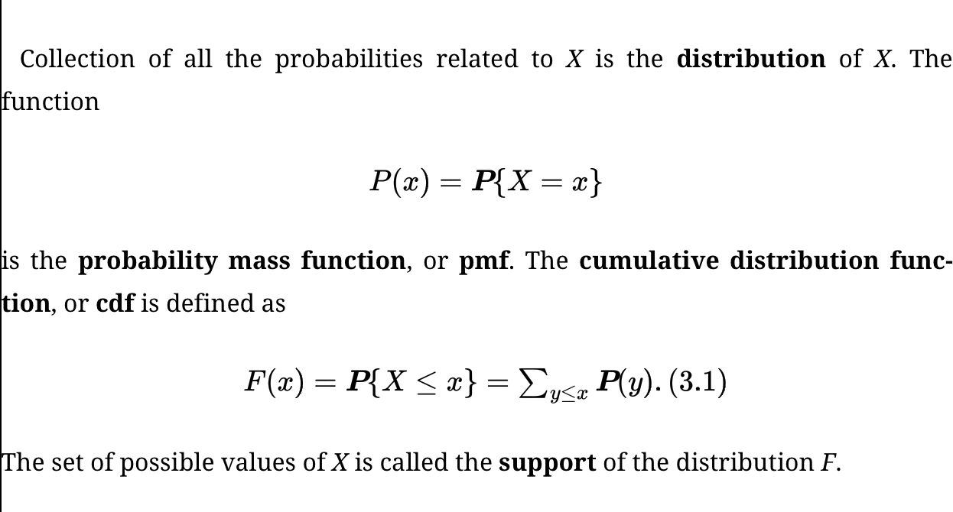
Probability Mass Function-PMF (Discrete Variables)

Slide 8
Probability Mass Function-PMF (Discrete Variables)
Let, a dice roll, and the probability of a particular side will come is equal and it is: 1/6=0.167 (Considering a fair roll of the dice executed).
So, the probabilities are:
x (A possible outcome) | P(X=x)
1 | 1/6=0.166666667
2 | 1/6=0.166666667
3 | 1/6=0.166666667
4 | 1/6=0.166666667
5 | 1/6=0.166666667
6 | 1/6=0.166666667

Slide 9
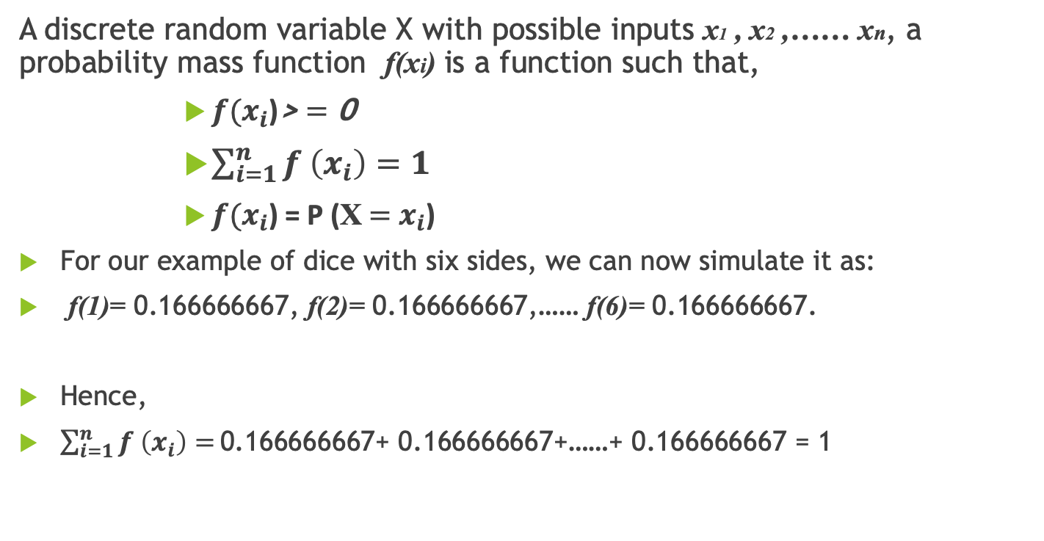
Probability Mass Function-PMF Notation
A discrete random variable X with possible inputs x1 , x2 ,…… xn, a probability mass function f(xi) is a function such that,
${f(x}_{i}\text{)}$> $=$ 0
$\sum_{i=1}^{n}{f \left(x_{i}\right)=1}$
${f(x}_{i}$) = P (X $=$ $x_{i}$)
For our example of dice with six sides, we can now simulate it as:
f(1)= 0.166666667, f(2)= 0.166666667,…… f(6)= 0.166666667.
Hence,
$\sum_{i=1}^{n}{f \left(x_{i}\right)=}\text{0.166666667}$+ 0.166666667+……+ 0.166666667 = 1

Slide 10
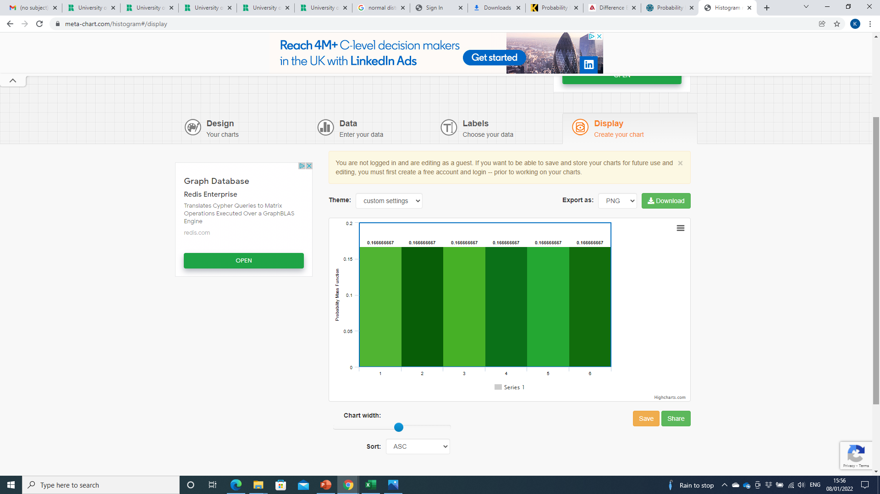
Probability Mass Function-PMF Continued..

Slide 11
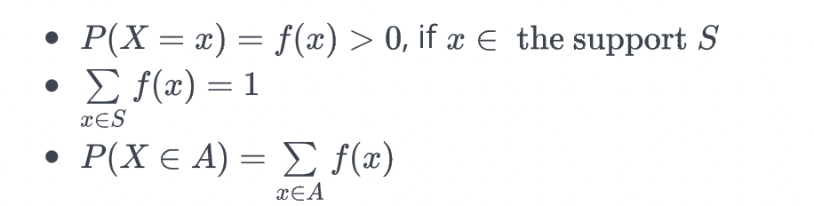
Probability Mass Function continued
The probability mass function, P(X=x)=f(x), of a discrete random variable X is a function that satisfies the following properties:

Slide 12
Probability Mass Function Continued
First item basically says that, for every element x in the support S, all of the probabilities must be positive. Note that if x does not belong in the support S, then f(x)=0. The second item basically says that if you add up the probabilities for all of the possible x values in the support S, then the sum must equal 1. And, the third item says to determine the probability associated with the event A, you just sum up the probabilities of the x values in A.
Since f(x) is a function, it can be presented:
in tabular form
in graphical form
as a formula

Slide 13
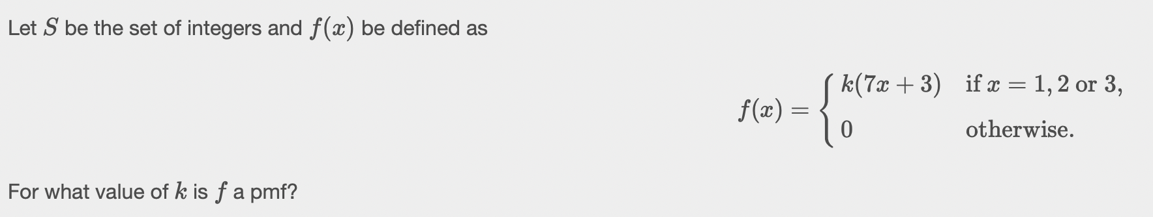
Worked Example

Slide 14
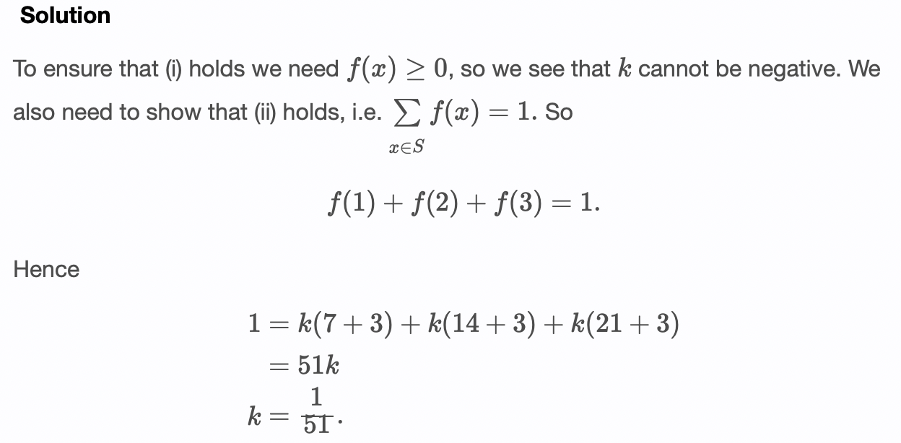
Solution

Slide 15
Characteristics of Random Variables
Expectation
Variance
Standard deviation

Slide 16
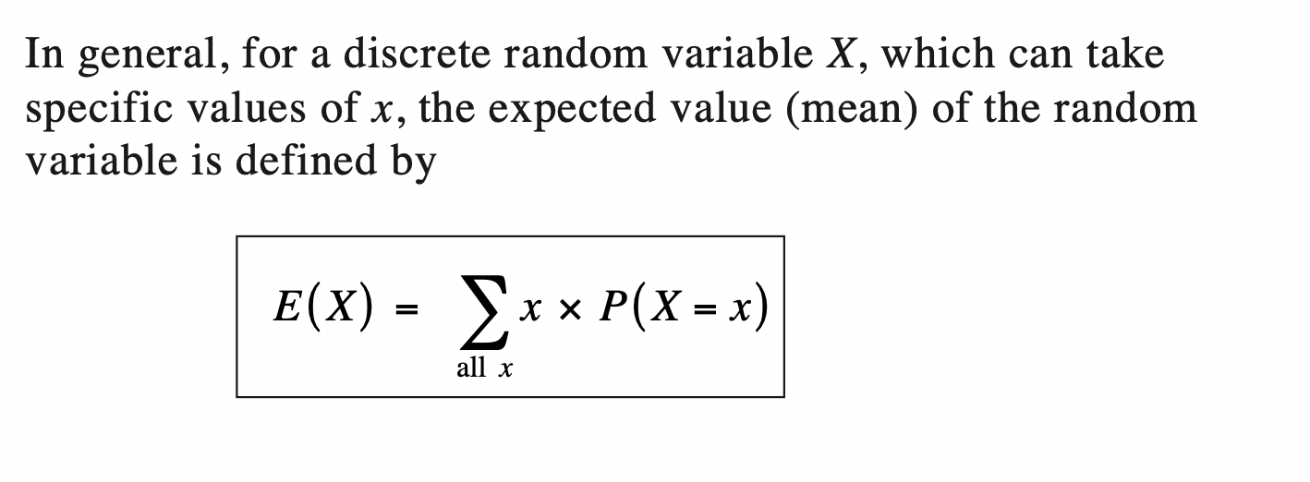
Expectation
Expectation or expected value of a random variable X is its mean, the average value.

Slide 17
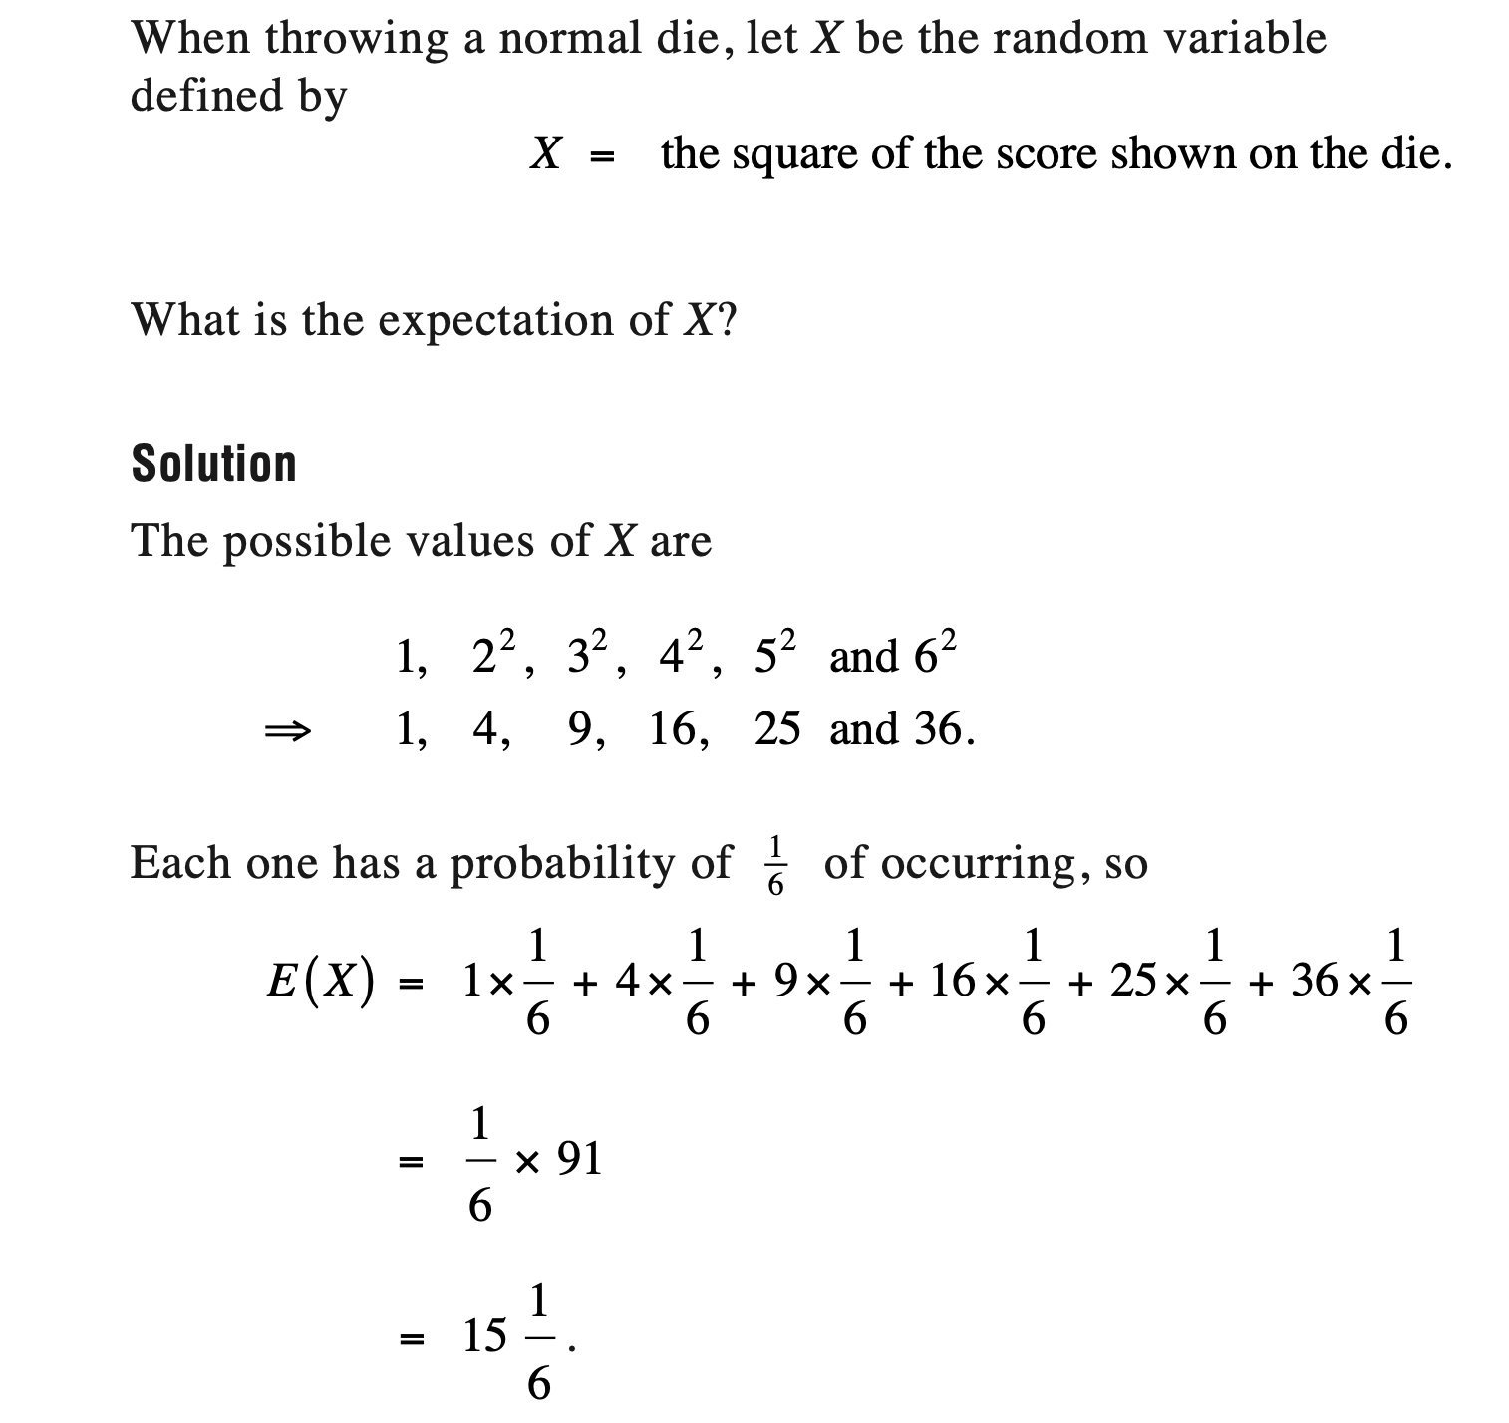
Expectation-Example

Slide 18
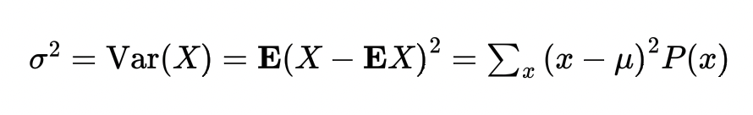

Variance and Standard Deviation
Variance of a random variable is defined as the expected squared deviation from the mean. For discrete random variables, variance is
Standard Deviation is square root of variance

Slide 19

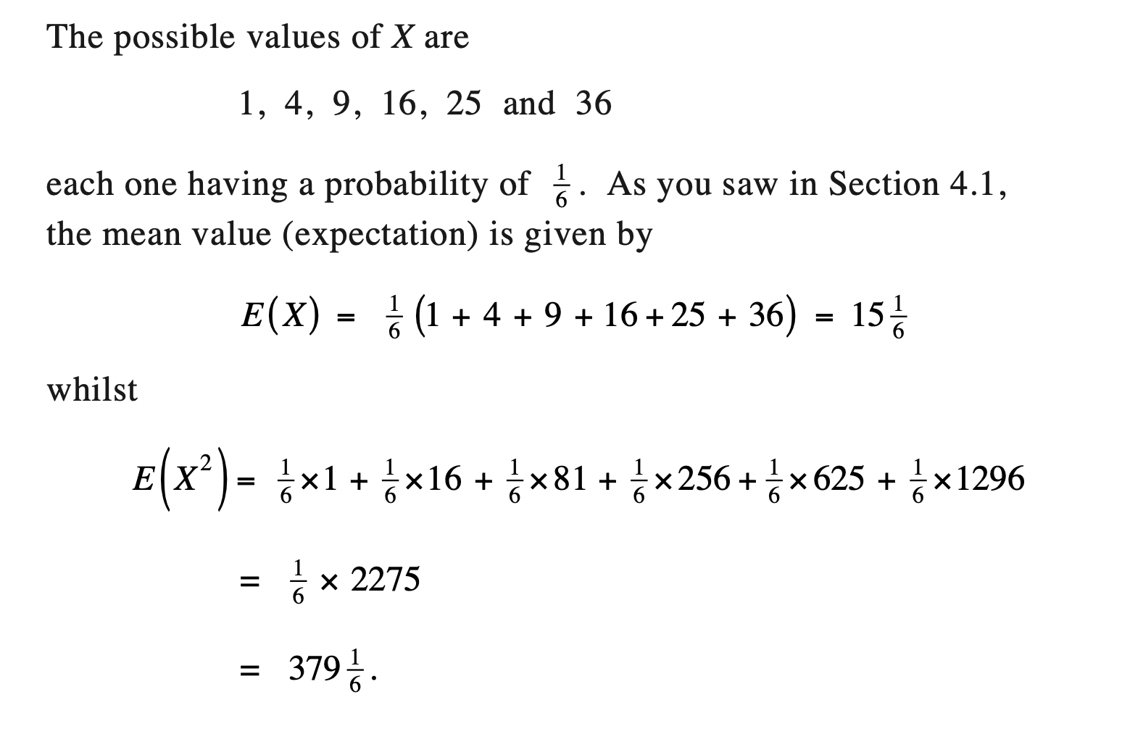
Example

Slide 20
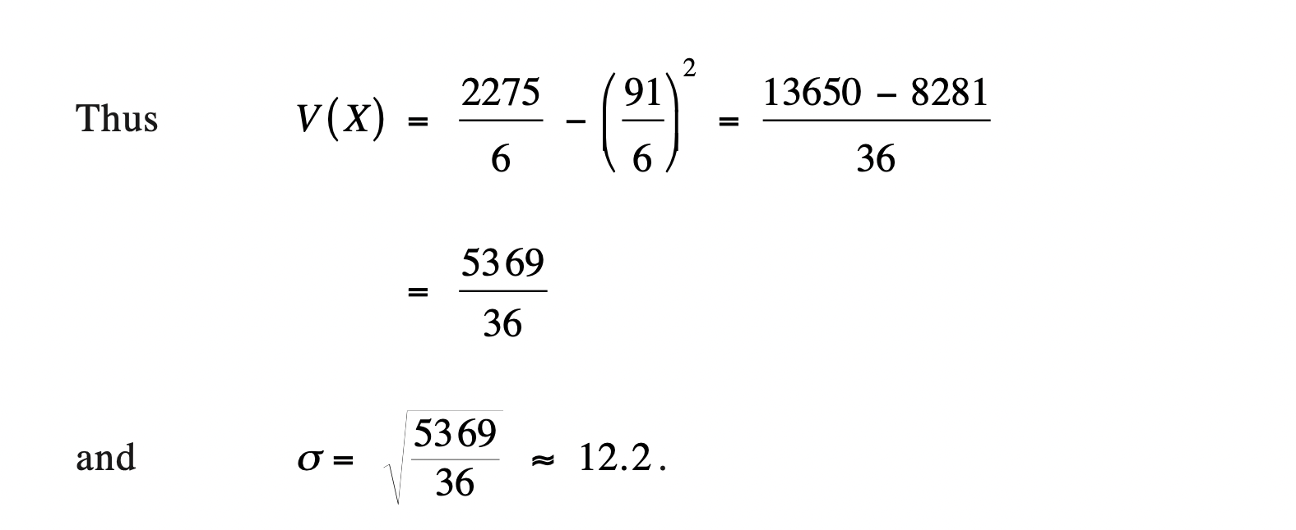
Example Continued

Slide 21
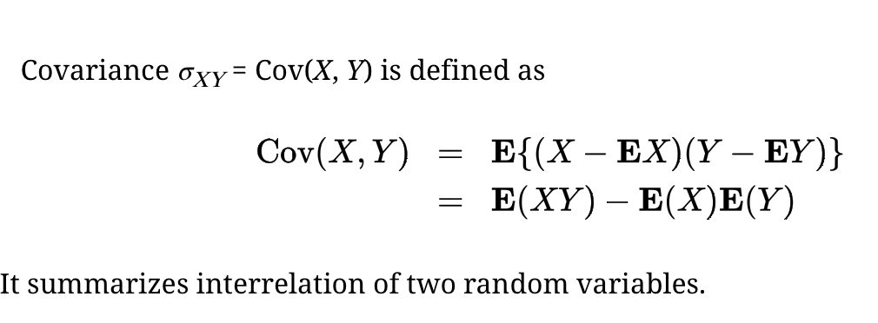
Covariance and correlation
Expectation, variance, and standard deviation characterize the distribution of a single random variable. Now we introduce measures of association of two random variables.

Slide 22
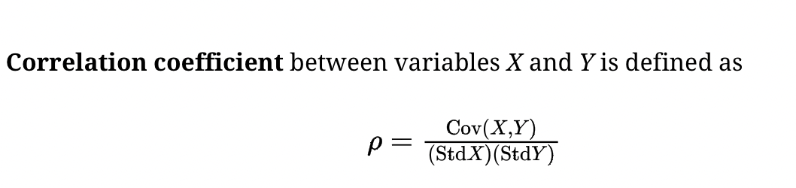
Correlation

Slide 23
Covariance and Correlation
In essence, covariance represents the ability of two variables to increase or decrease together with respect to their mean values. Covariance can be positive, negative, or zero.
Correlation is a normalized version of covariance. Covariance is a quantity that depends on the units of the variables used. Thus, if the units of either or both of the variables are changed, the digits of covariance change too. For solving this problem of units, correlation was introduced. Correlation can be positive, negative, or neutral.

Slide 24
Families of Discrete Distributions
Bernoulli Distribution
Binomial Distribution

Slide 25
Bernoulli Distribution
A random variable with two possible values, 0 and 1, is called a Bernoulli variable, its distribution is Bernoulli distribution, and any experiment with a binary outcome is called a Bernoulli trial.
Good or defective components, parts that pass or fail tests, transmitted or lost signals, working or malfunctioning hardware, benign or malicious attachments, sites that contain or do not contain a keyword, girls and boys, heads and tails, and so on, are examples of Bernoulli trials.
All these experiments fit the same Bernoulli model, where we shall use generic names for the two outcomes: “successes” and “failures.”

Slide 26
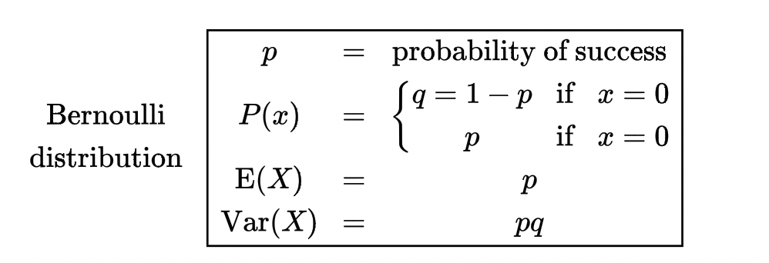
Bernoulli Distribution continued

Slide 27
Bernoulli Distribution Example
A basketball player can shoot a ball into the basket with a probability of 0.6. What is the probability that he misses the shot?
Solution: We know that success probability P (X = 1) = p = 0.6 Thus, probability of failure is P (X = 0) = 1 - p = 1 - 0.6 = 0.4 Answer: The probability of failure of the Bernoulli distribution is 0.4

Slide 28
Binomial Distribution
Now consider a sequence of independent Bernoulli trials and count the number of successes in it. This may be the number of defective computers in a shipment, the number of updated files in a folder, the number of girls in a family, the number of e-mails with attachments, etc.
A variable described as the number of successes in a sequence of independent Bernoulli trials has Binomial distribution. Its parameters are n, the number of trials, and p, the probability of success.

Slide 29
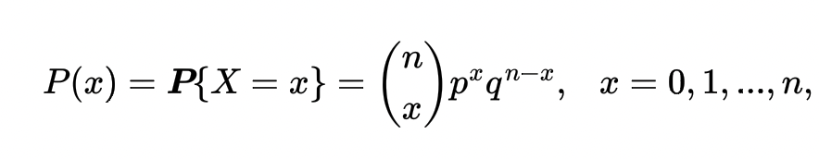
Binomial Probability Mass Function

Slide 30
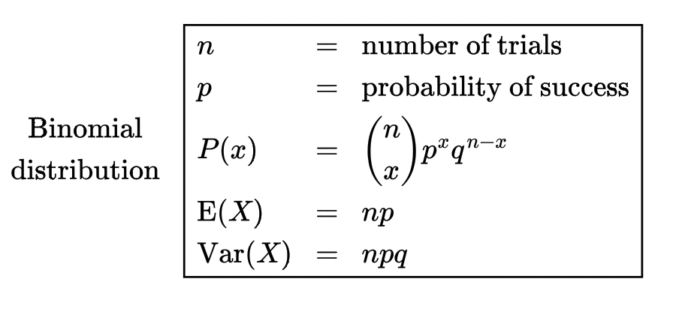
Binomial Distribution continued
Each Bernoulli trial is associated with a Bernoulli variable that equals 1 if the trial results in a success and 0 in case of a failure. Then, a sum of these variables is the overall number of successes. Thus, any Binomial variable X can be represented as a sum of independent Bernoulli variables,

Slide 31
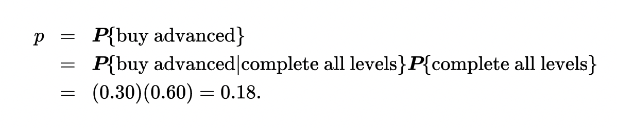
Binomial Distribution Example
An exciting computer game is released. Sixty percent of players complete all the levels. Thirty percent of them will then buy an advanced version of the game. Among 15 users, what is the expected number of people who will buy the advanced version? What is the probability that at least two people will buy it?
Solution. Let X be the number of people (successes), among the mentioned 15 users (trials), who will buy the advanced version of the game. It has Binomial distribution with n = 15 trials and the probability of success

Slide 32
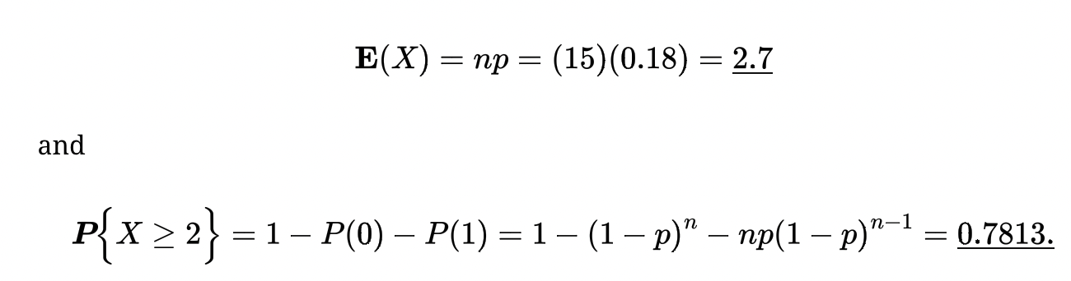
Continued
Then we have

Slide 33
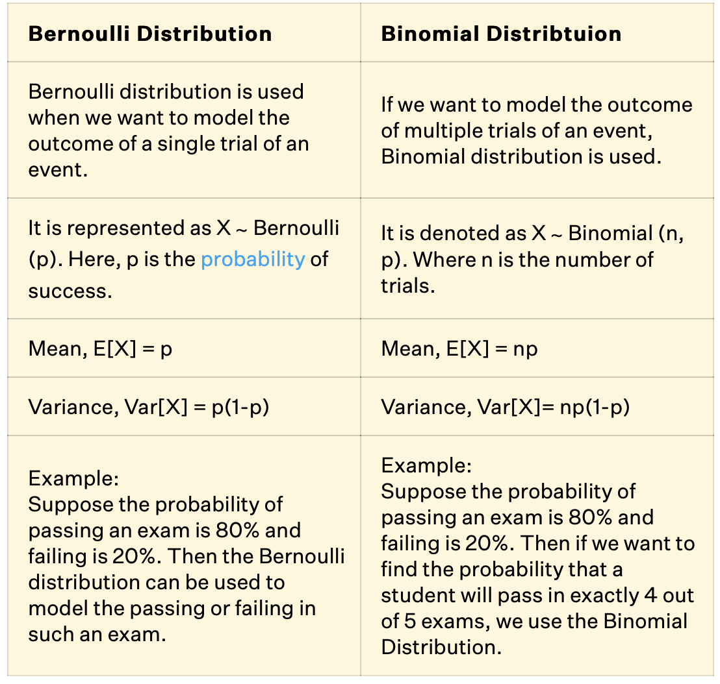

Slide 34
Geometric Distribution
Again, consider a sequence of independent Bernoulli trials. Each trial results in a “success” or a “failure.”
The number of Bernoulli trials needed to get the first success has Geometric distribution.

Slide 35
Examples
A search engine goes through a list of sites looking for a given key phrase. Suppose the search terminates as soon as the key phrase is found. The number of sites visited is Geometric.
A hiring manager interviews candidates, one by one, to fill a vacancy. The number of candidates interviewed until one candidate receives an offer has Geometric distribution.

Slide 36
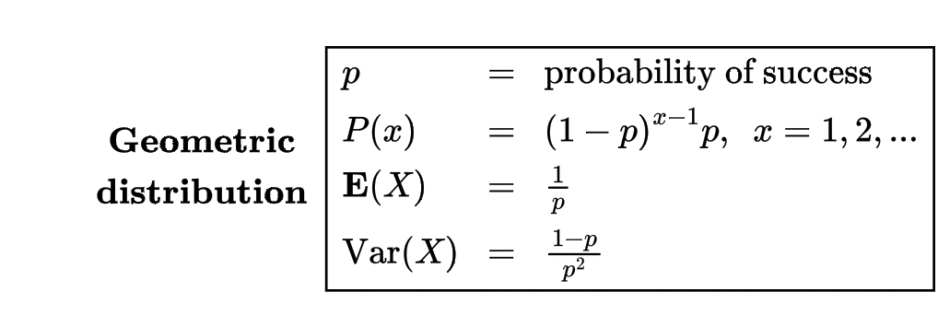
Geometric Distribution Function

Slide 37
Example
Suppose it’s known that 4% of individuals who visit a certain bank are visiting to file bankruptcy. Suppose a banker wants to know the probability that he will meet with less than 10 people before encountering someone who is filing for bankruptcy.
Solution:
p = 0.04 and x = 10 to find that the probability that he meets with less than 10 people before encountering someone who is failing for bankruptcy is 0.33517.

Slide 38

Any questions? Let’s move on to the worksheet

